Slide 1

Exploratory Data Analysis on AMCAT Data

Slide 2
About me
Name:Aleena Joseph
I am currently pursuing BTech in Computer Science from College of Engineering Kallooppara.
Linkedin url: https://www.linkedin.com/in/aleenajoseph2003
Github link: https://github.com/aleenaj23

Slide 3
OBJECTIVE
Objective of the project is to perform exploratory data analysis on the given dataset to extract insights and patterns from the data, particularly focusing on ‘salary’ as the target variable.

Slide 4
Summary of the data
The dataset contains the employment outcomes of engineering graduates as dependent variables (Salary, Job Titles, and Job Locations) along with the standardized scores from three different areas – cognitive skills, technical skills and personality skills. The dataset also contains demographic features. The dataset contains around 40 independent variables and 4000 data points. The independent variables are both continuous and categorical in nature.

Slide 5
Exploratory Data Analysis
Data cleaning
Data manipulation
Univariate Analysis
Bivariate Analysis

Slide 6
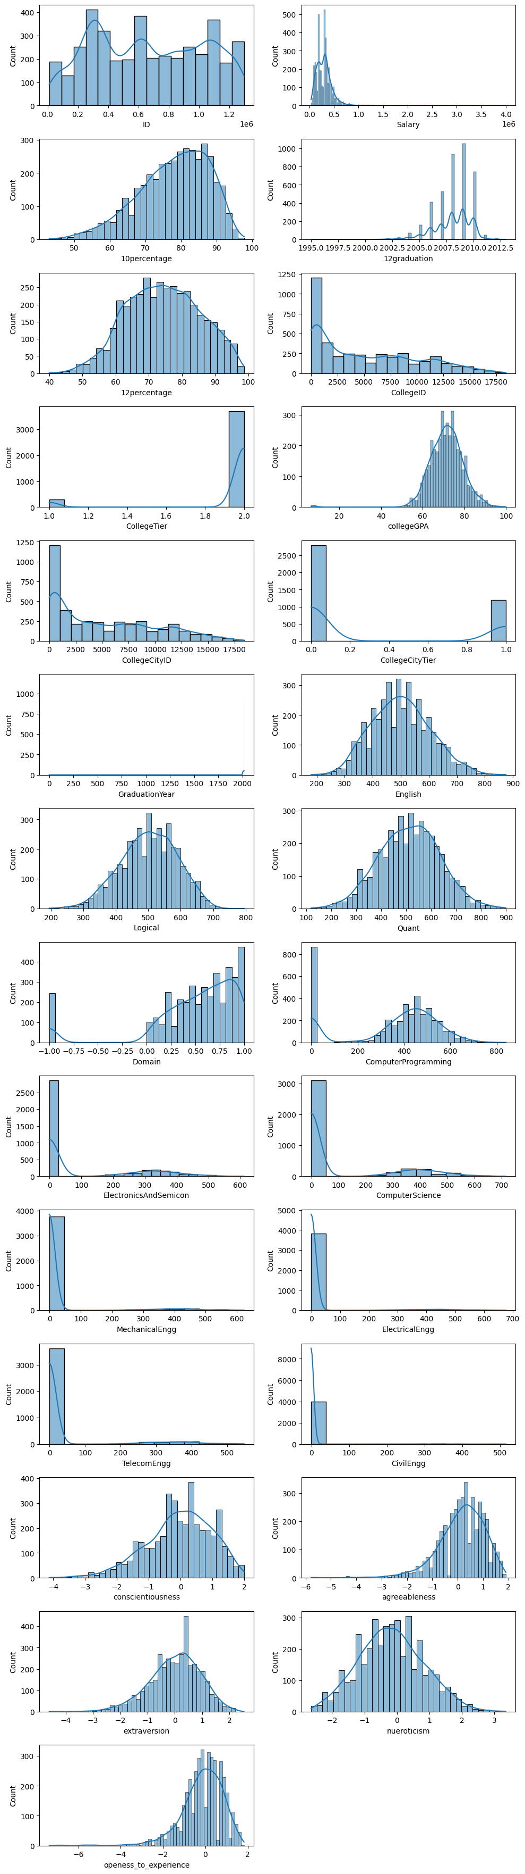

Slide 7
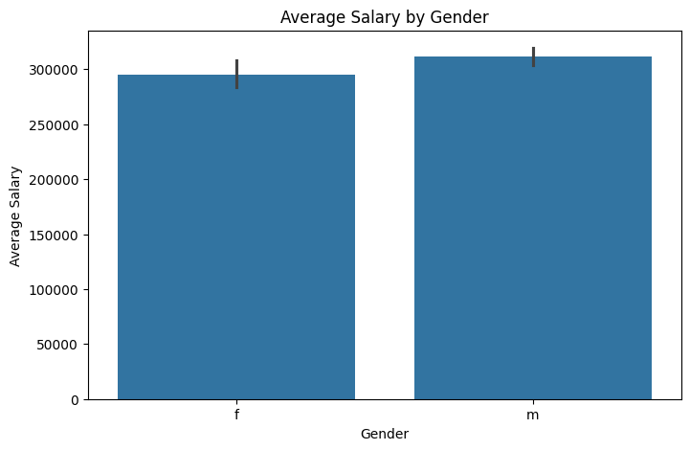

Slide 8
Conclusion
Both the time an employee has been with the company and their salaries tend to have more people with less experience and lower pay, indicating possible problems with employee retention and uneven salary distribution.
No connection was found between salary and educational performance (in 10th grade, 12th grade, and GPA). This implies that how well someone does academically does not strongly affect their salary.
When it comes to gender, the average salaries for both men and women are about the same. This means there is no unfair difference in how salaries are distributed between genders.

Slide 9

THANK YOU

